Slide 1
Discussion Week 6
SACHIN KRISHNA BHAT
Lab 1D
http://web.cs.ucla.edu/classes/spring17/cs111/projects/P2A.html

Slide 2
We will Discuss
Pthread example
Mutex example
Spin and lock example
Compare and swap example
Part 1
Part 2

Slide 3
What a Thread is?
Threads can be viewed as procedures that can run independently.
Threads duplicate only bare essential resources that enable them to run, hence making it lightweight.
Pthreads
https://computing.llnl.gov/tutorials/pthreads/#Thread

Slide 4
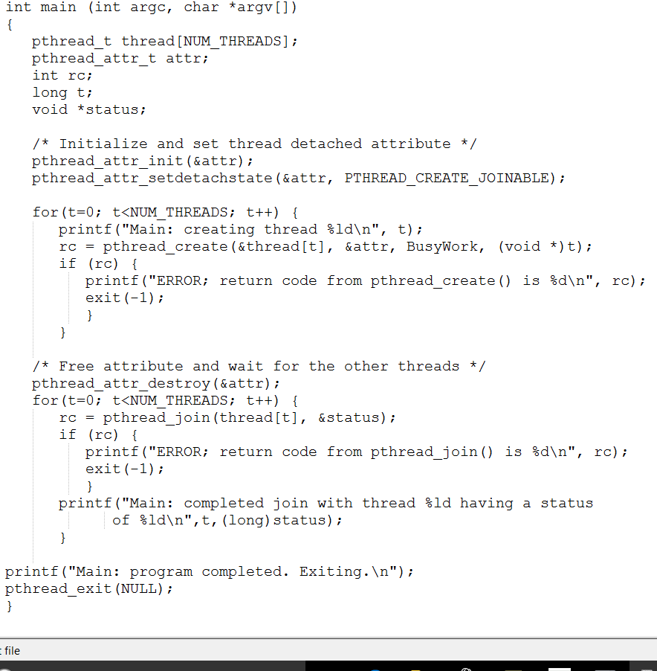
Pthread example

Slide 5
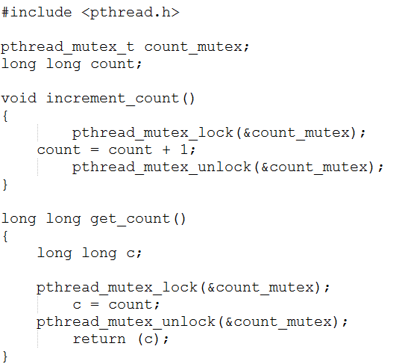
Mutex example

Slide 6
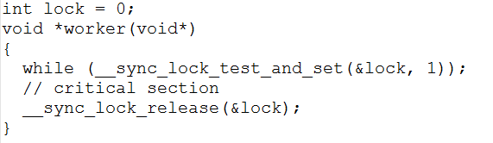
Spin and lock example
Test-And-Set. The test and set instruction atomically checks if a memory location is zero, and if so, sets the memory location to 1.
If the memory location is 1, it does nothing. It returns the old value of the memory location.
You can use test and set to implement locks as follows:
The lock state is implemented by a memory location.
The location is 0 if the lock is unlocked and 1 if the lock is locked.
The lock operation is implemented as:while (test-and-set(l) == 1);
The unlock operation is implemented as: *l = 0;

Slide 7
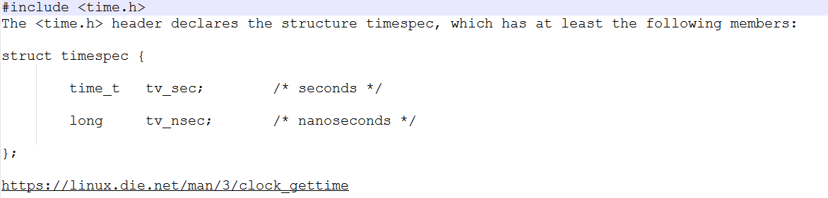
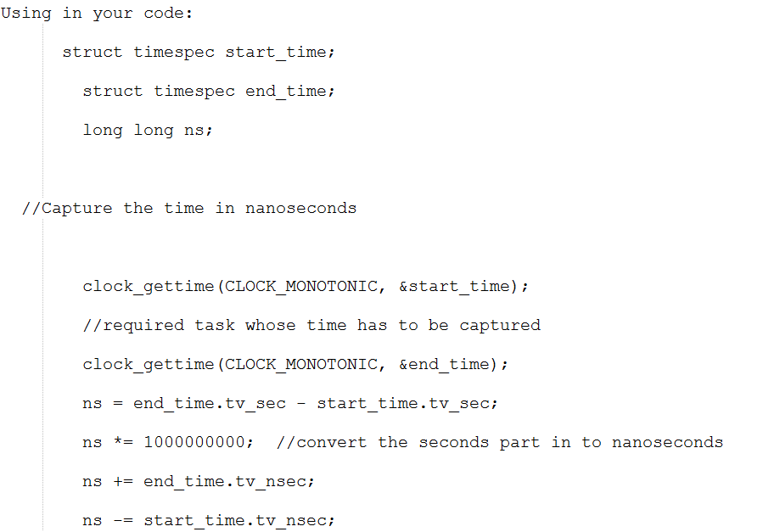

Slide 8
Compare and Swap
void cas_example(int *ptr, int val ) {
int old, new;
do {
old = *ptr;
new = old + val;
} while( __sync_val_compare_and_swap(ptr, old, new) != old);
}
int CAS(int *ptr, int oldvalue, int newvalue) {
int temp = *ptr;
if(*ptr == oldvalue)
*ptr = newvalue;
return temp;
}

